Slide 1





New RF control system developments at LNF-INFN
Serenellini B., Bellaveglia M., Fang X., Gallo A., Latini G., Michelotti A., Magnanimi R., Piersanti L., Scarselletta G., Tocci S. - INFN

Slide 2
New RF control system developments at LNF-INFN
SPARC_LAB facility at the Frascati National Laboratories
Upgrade of the SPARC_LAB LLRF systems
New RF control system – Migration to EPICS:
New machine’s synoptic and LLRF control panels
Development of softIOC dedicated to managing custom hardware for fast feedbacks and RF synchronization
New dedicated software for automatic RF plant management
Ongoing development of a custom EPICS application aimed at optimizing system resources

Slide 3
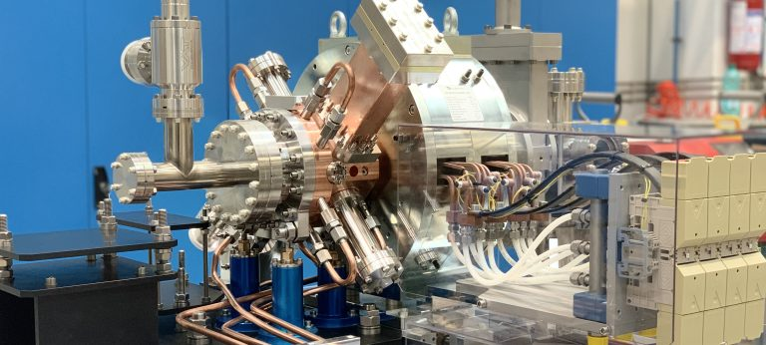
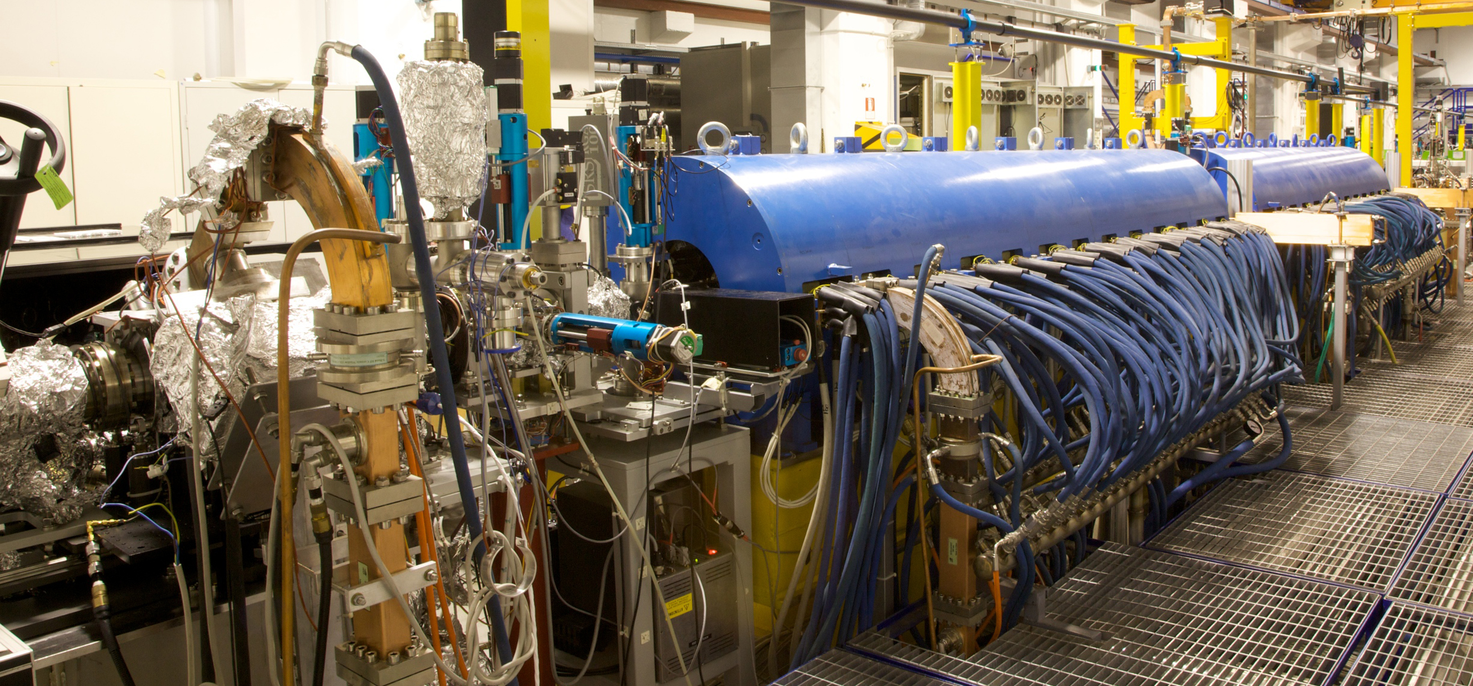
SPARC_LAB facility at the Frascati National Laboratories
SPARC_LAB (Sources for Plasma Accelerators and Radiation Compton with Laser And Beam) was founded in 2004 as an R&D activity for the development of a high-brightness electron photoinjector dedicated to FEL experiments. It consists of:
an S-band RF Gun with 1.6 SLAC-type cells manufactured using clamping technology that avoids the brazing process, provides a peak electric field of 120 MV/m, and uses a copper photocathode. Electron extraction is achieved using UV laser pulses (266 nm, 4.66 eV);
a Booster linac: 2 S-band SLAC-type TW structures + 1 C-band structure (electron beams with energies up to 150 MeV on crest are generated). Magnetic focusing and emittance control are provided by built-in solenoid coils;
a Plasma interaction chamber for studying and optimizing beam-driven plasma acceleration schemes.
The SABINA (Source of Advanced Beam Imaging for Novel Applications) project, co-funded by the Lazio Regional Government, to consolidate SPARC_LAB, has recently completed its upgrade operations. The updates involved several aspects of the facility (RF gun, photocathode laser, focusing solenoids), including the Low Level RF systems, the Master Oscillator, and the reference distribution.

Slide 4
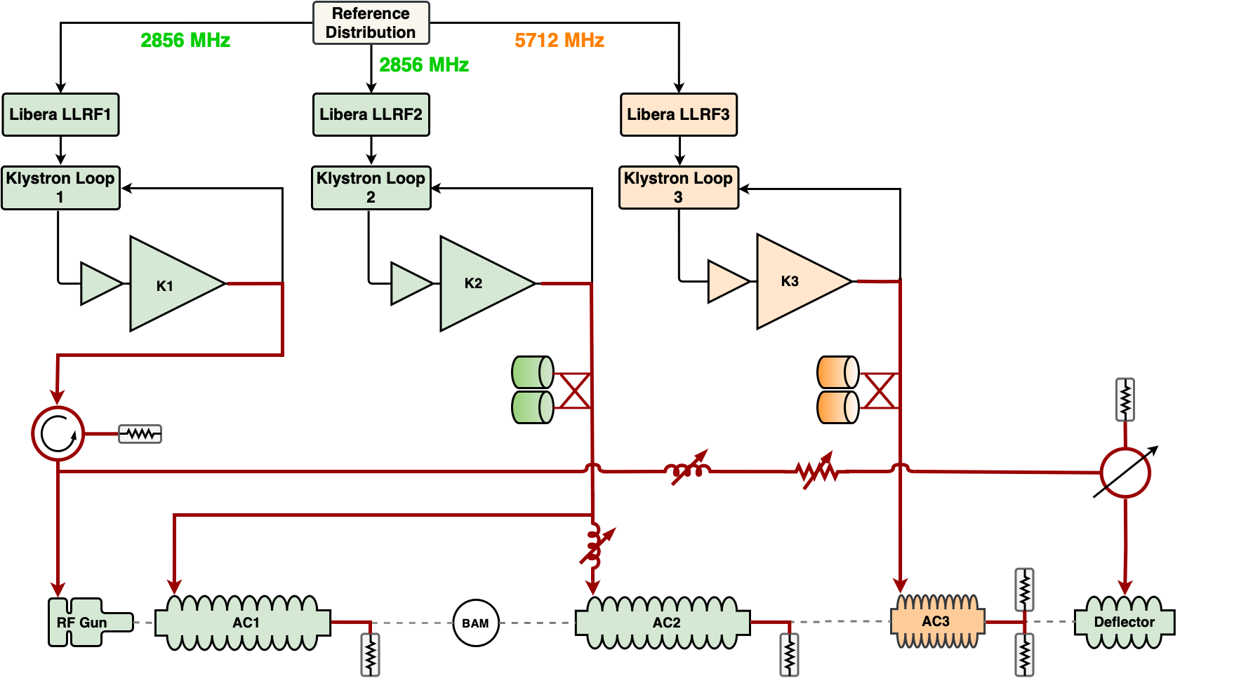
The SPARC_LAB LLRF system
The HV for S-band klystrons is generated by PFN (Puls-PlasmaTechnik) modulators. For the C-band, a solid-state modulator (Scandinova, Sweden) is used;
The first S-band klystron drives the RF gun and the deflection cavity for beam diagnostics;
The second S-band klystron drives the two accelerating structures with the SLED pulse compressor;
The C-band line acts as a booster;
An intra-pulse phase feedback system is implemented for each line, capable of acting on the phase jitter of the klystron within a single RF pulse.
As described by L. Piersanti in: “Achieving Ultra-Stable RF Control for Plasma Acceleration at LNF-INFN ”

Slide 5
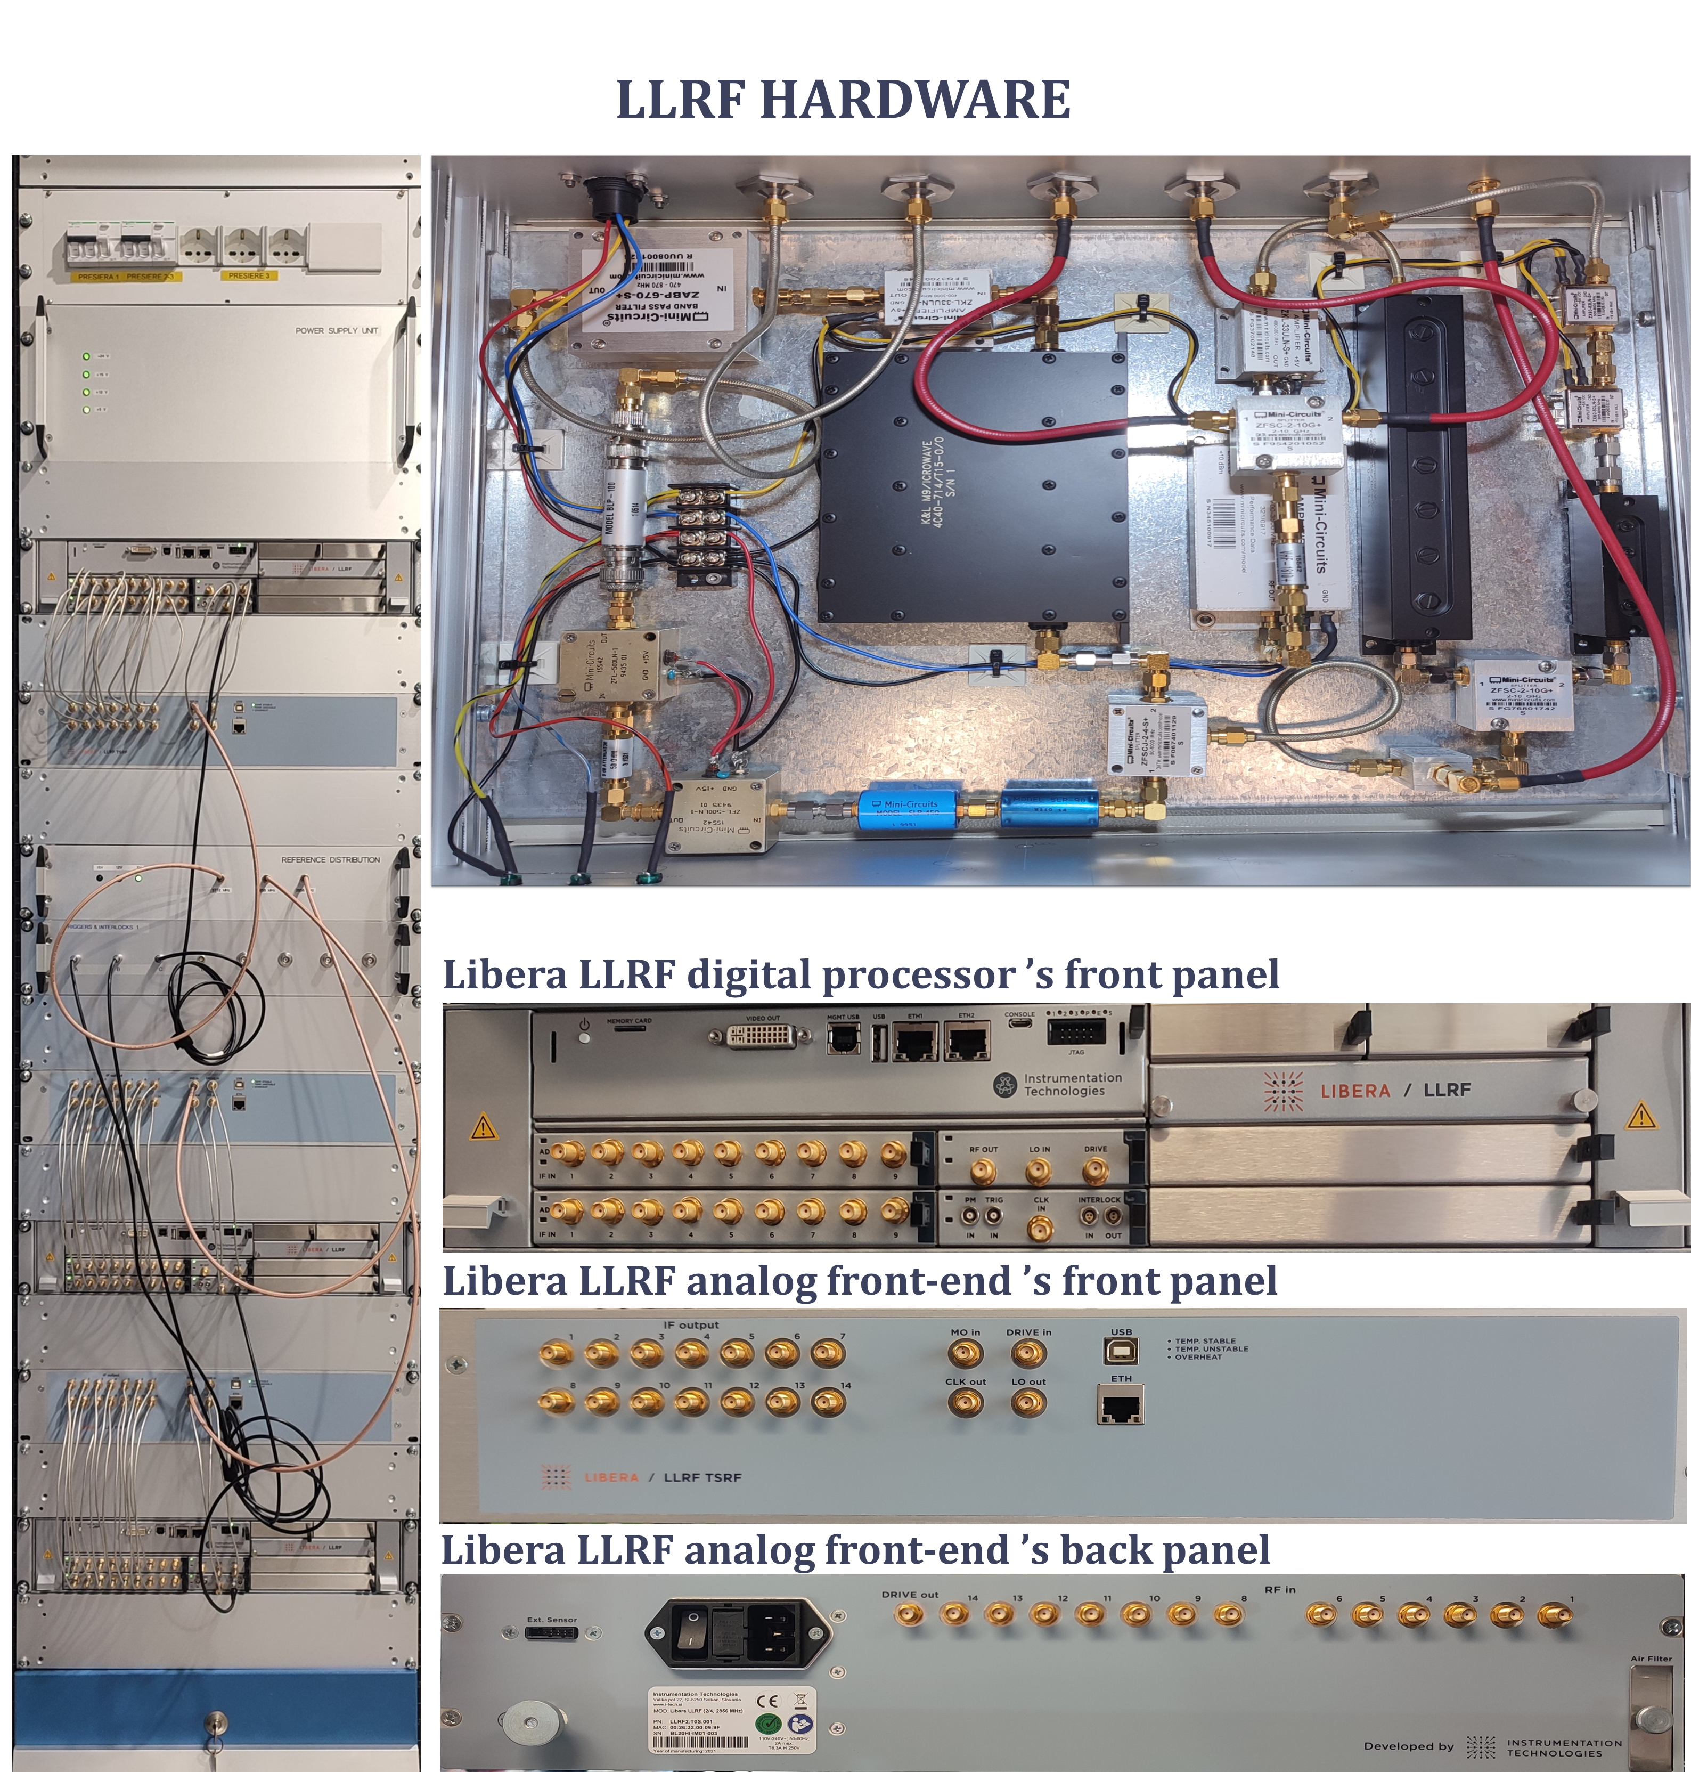
The new Libera LLRF systems
Reasons for the update:
Previous systems were limited in terms of noise and offset;
Signals were acquired on commercial digital boards, which have a non-negligible fault rate;
The front-end noise of ∼50 fs was too high compared to today's requirements (<10 fs);
Non-arbitrary pulse shape.
Temperature-stabilized front end, IF = 44.625 MHz, 16-bit ADC at 119 MS/s, 5 MHz BW;
Two independent pulse-to-pulse feedbacks of amplitude and phase;
Long-term stability (24 hours) of the RF station: <100 fs rms;
Fully customizable pulse shape (A, φ), FPGA-driven analog VM (14-bit DAC), 16 MHz BW;
Resolution: Amplitude <0.1 % rms;
Added phase jitter <10 fs rms.
Libera LLRF (Instrumentation Technologies) features:

Slide 6
New RF control system – Migration to EPICS
Before the SABINA project upgrade, each instrument was managed by separate LabVIEW software running on local controllers, each with its own configuration. Today, the control is centralized in EPICS: the softIOCs run in Kubernetes via Epik8s, with automatic Git-based synchronization through ArgoCD.
As part of the SABINA project, the RF control system has been completely updated. Control panels have been developed for the new LLRF systems and allow remote management of:
RF output power;
Pulse shape;
Amplitude and phase feedback;
Interlock management;
additional panels have also been developed for measurements and statistics.
The recent upgrade of the fast intra-pulse phase feedback of the klystron required the development of a remote control system integrating the LLRF with the Red Pitaya platform used for managing the electronics.
New photocathode laser phase lock electronics, with a dedicated control panel for remote management via Red Pitaya.
Development of Python softIOCs for automatic conditioning: first for the C-band line, and then for the gun after the cathode replacement.
Ongoing development of a custom EPICS application for RF system management.

Slide 7
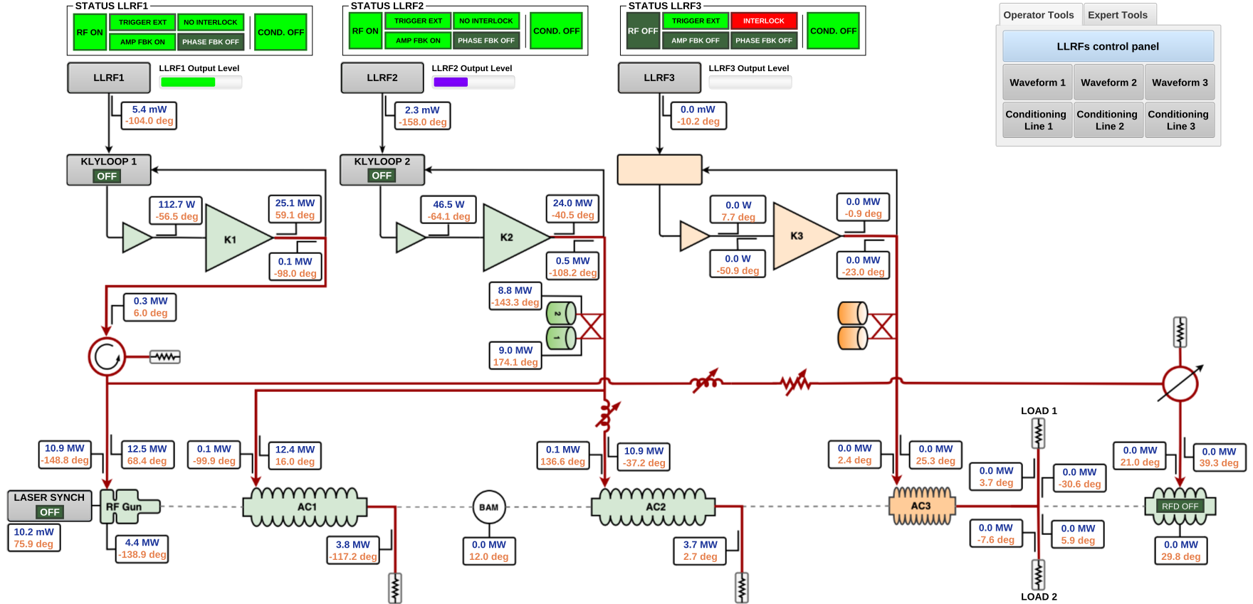
New RF control system - Synoptic

Slide 8
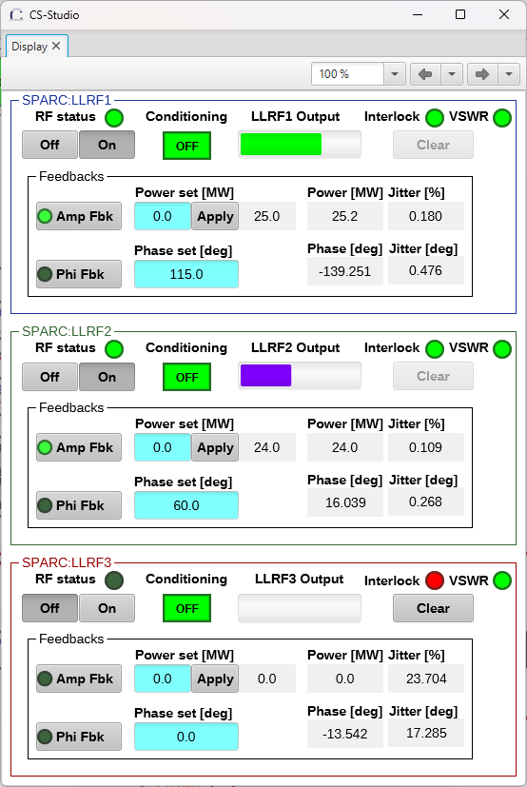


New RF control system – LLRF systems control panels

Slide 9
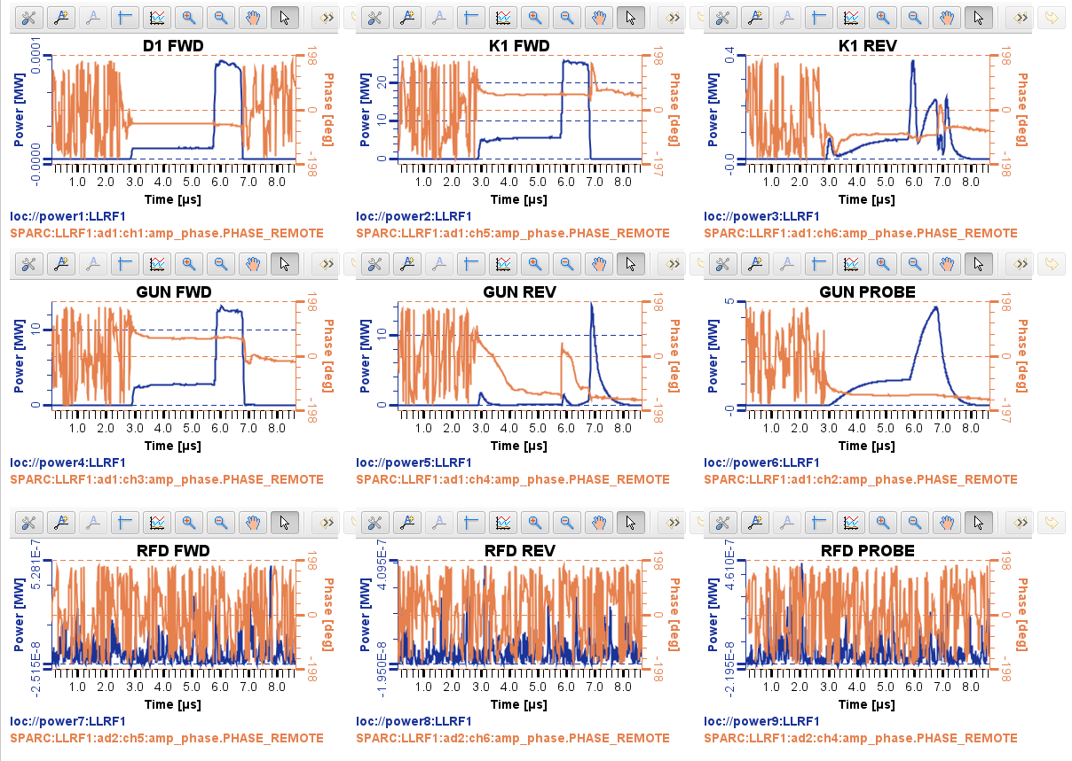




New RF control system – Waveforms panel

Slide 10
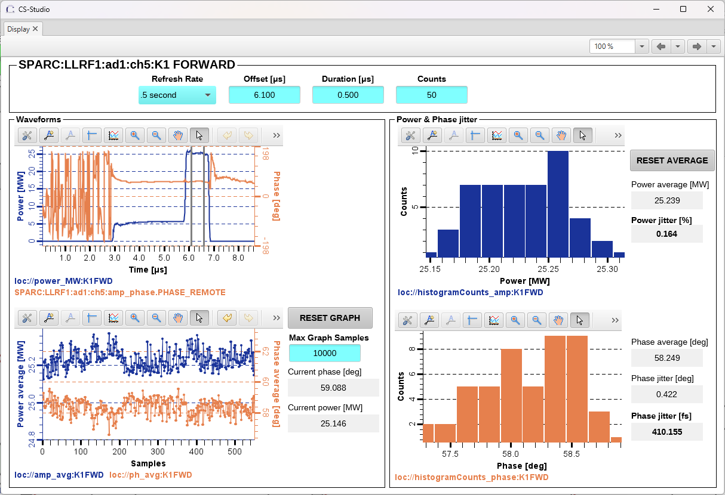


New RF control system – Measurements and statistics

Slide 11

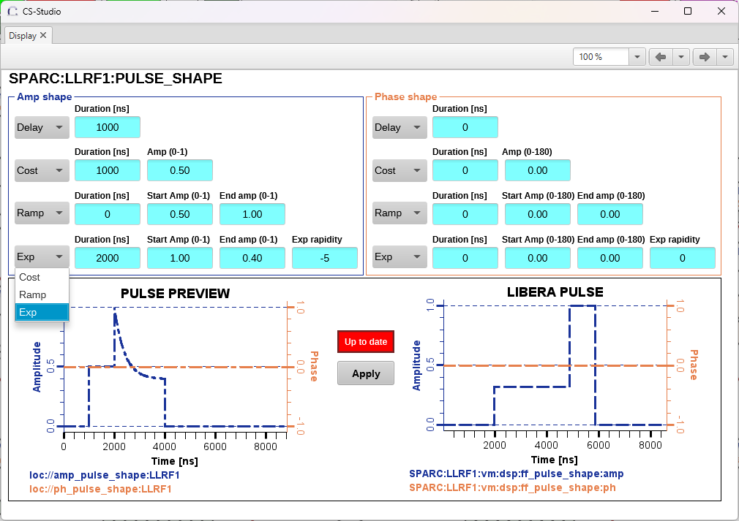



New RF control system – LLRF pulse shape control panel

Slide 12
New RF control system – Migration to EPICS
Before the SABINA project upgrade, each instrument was managed by separate LabVIEW software running on local controllers, each with its own configuration. Today, the control is centralized in EPICS: the softIOCs run in Kubernetes via Epik8s, with automatic Git-based synchronization through ArgoCD.
As part of the SABINA project, the RF control system has been completely updated. Control panels have been developed for the new LLRF systems and allow remote management of:
RF output power;
Pulse shape;
Amplitude and phase feedback;
Interlock management;
additional panels have also been developed for measurements and statistics.
The recent upgrade of the fast intra-pulse phase feedback of the klystron required the development of a remote control system integrating the LLRF with the Red Pitaya platform used for managing the electronics.
New photocathode laser phase lock electronics, with a dedicated control panel for remote management via Red Pitaya.
Development of Python softIOCs for automatic conditioning: first for the C-band line, and then for the gun after the cathode replacement.
Ongoing development of a custom EPICS application for RF system management.

Slide 13
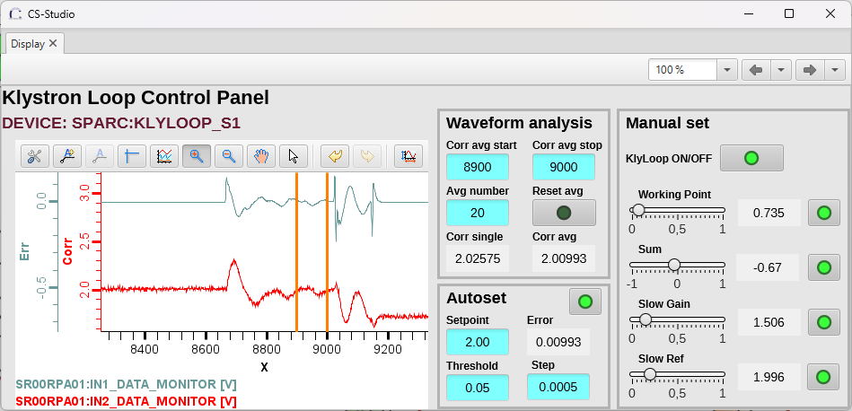

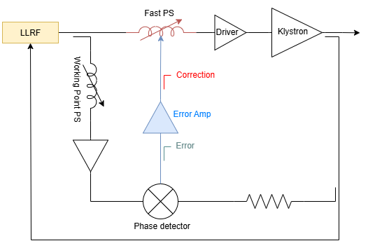
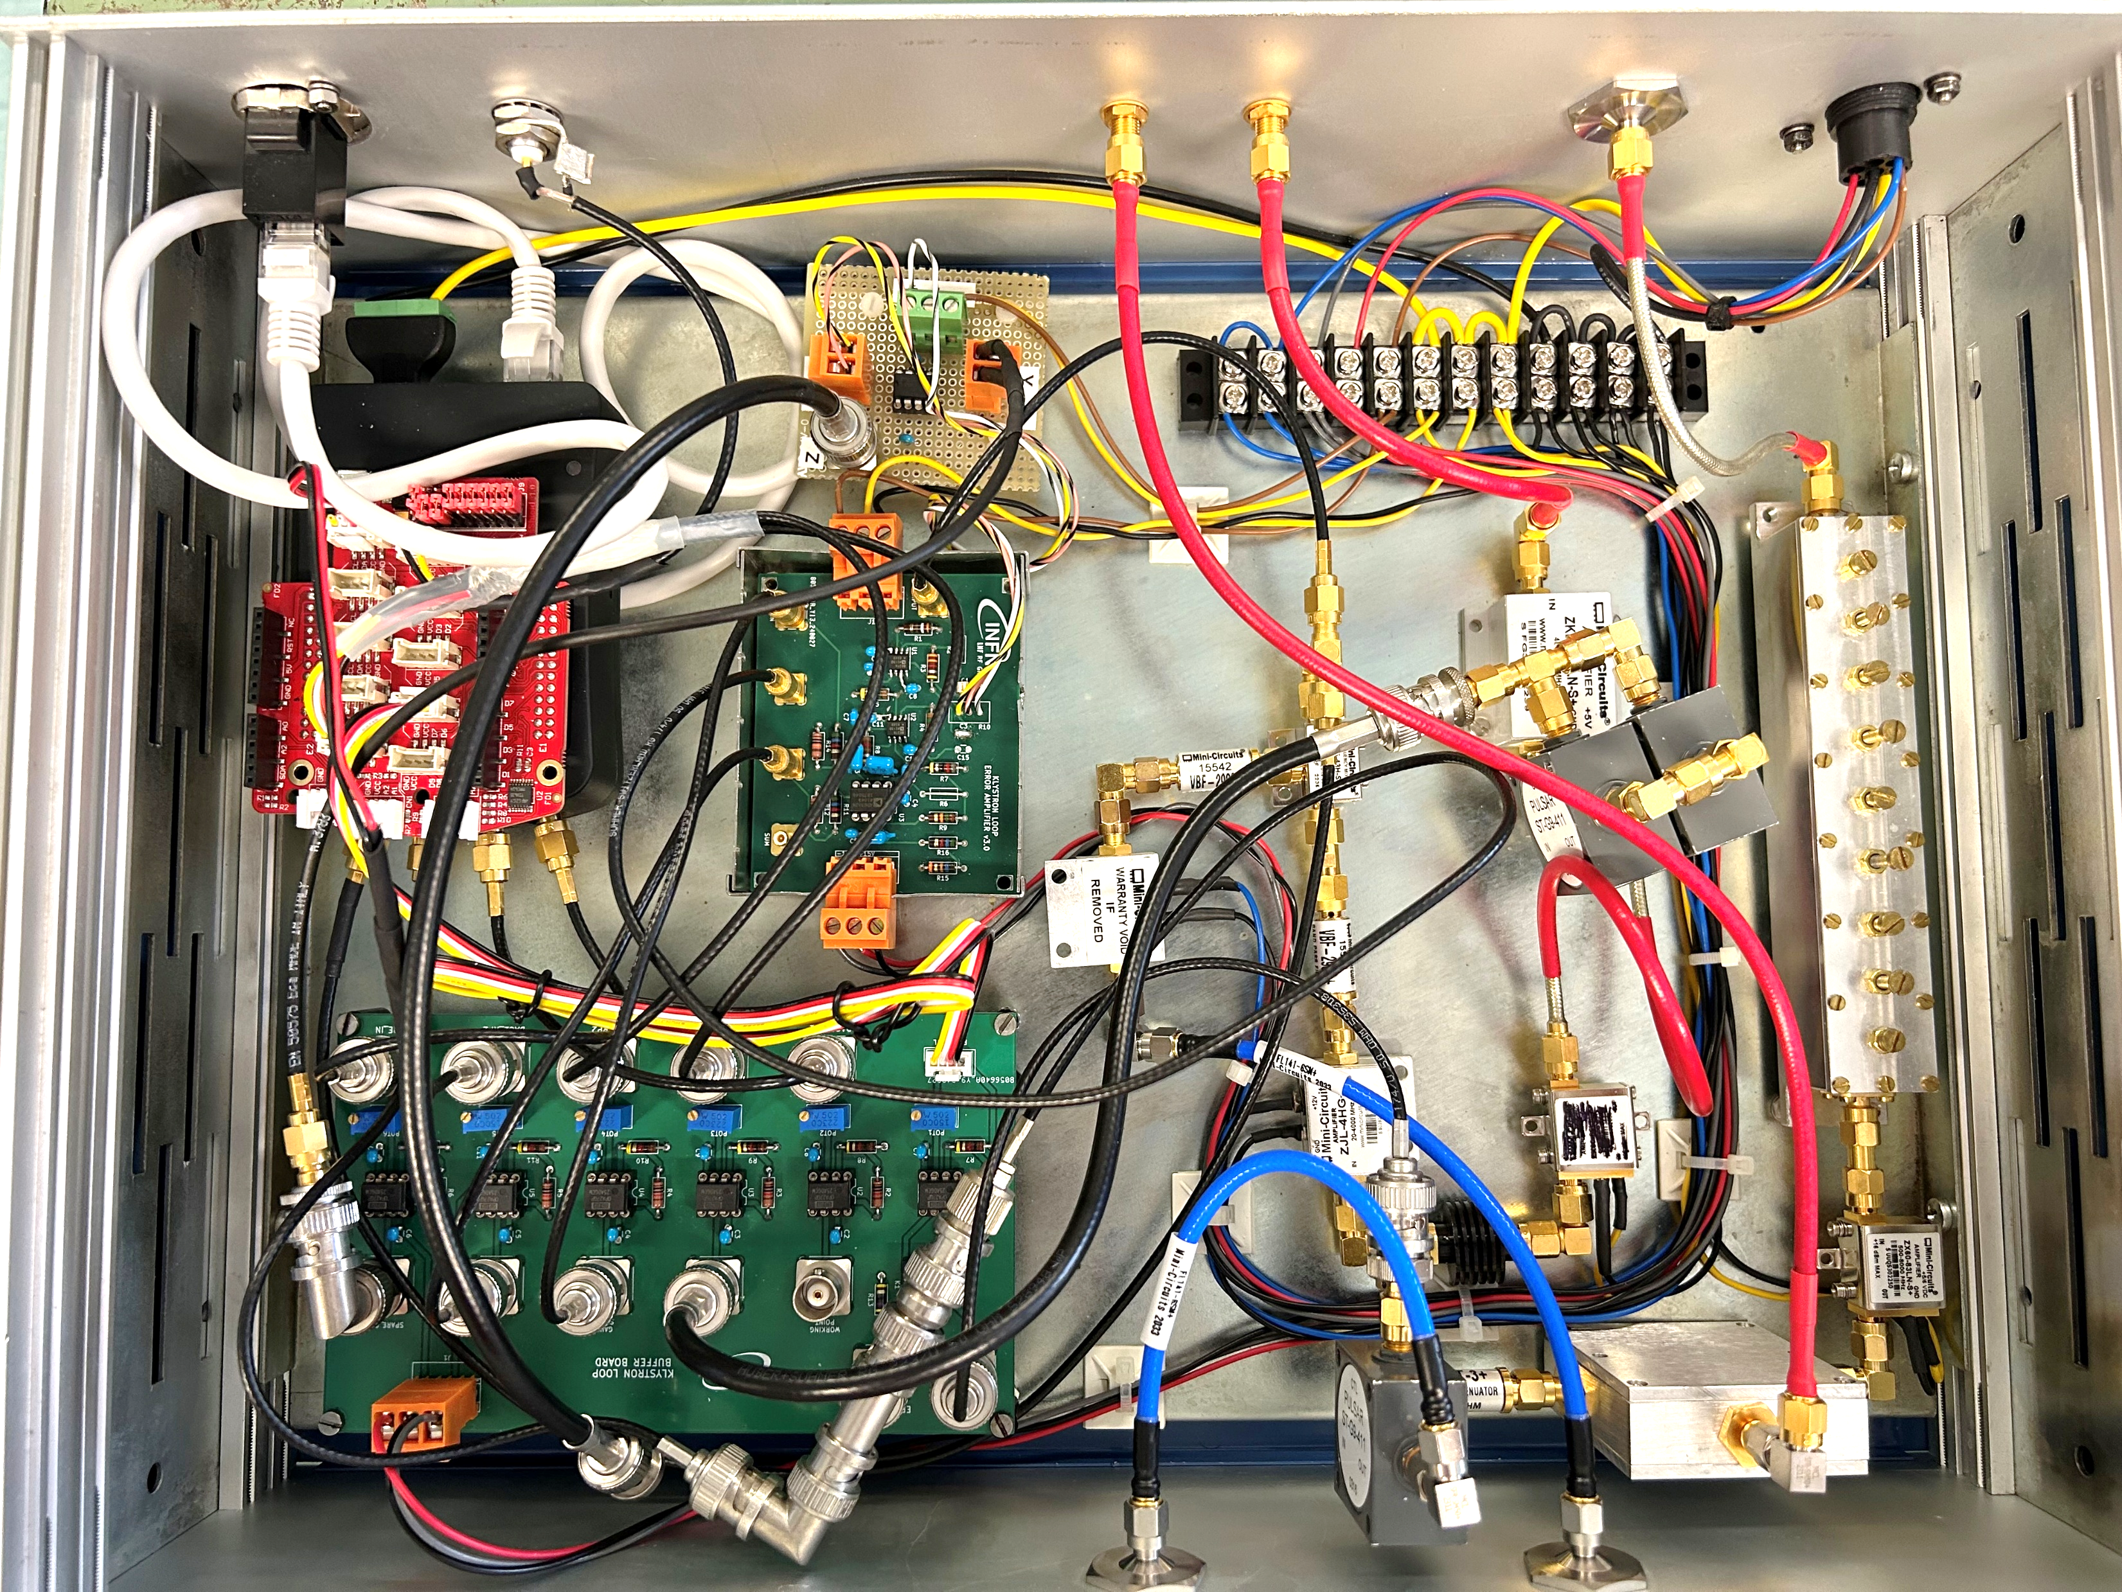



New RF control system - Fast intra-pulse phase feedback control panel

Slide 14
New RF control system – Migration to EPICS
Before the SABINA project upgrade, each instrument was managed by separate LabVIEW software running on local controllers, each with its own configuration. Today, the control is centralized in EPICS: the softIOCs run in Kubernetes via Epik8s, with automatic Git-based synchronization through ArgoCD.
As part of the SABINA project, the RF control system has been completely updated. Control panels have been developed for the new LLRF systems and allow remote management of:
RF output power;
Pulse shape;
Amplitude and phase feedback;
Interlock management;
additional panels have also been developed for measurements and statistics.
The recent upgrade of the fast intra-pulse phase feedback of the klystron required the development of a remote control system integrating the LLRF with the Red Pitaya platform used for managing the electronics.
New photocathode laser phase lock electronics, with a dedicated control panel for remote management via Red Pitaya.
Development of Python softIOCs for automatic conditioning: first for the C-band line, and then for the gun after the cathode replacement.
Ongoing development of a custom EPICS application for RF system management.

Slide 15
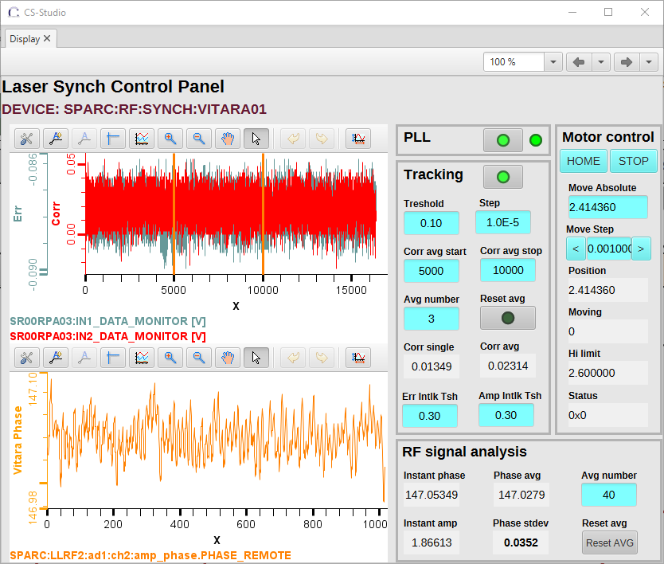
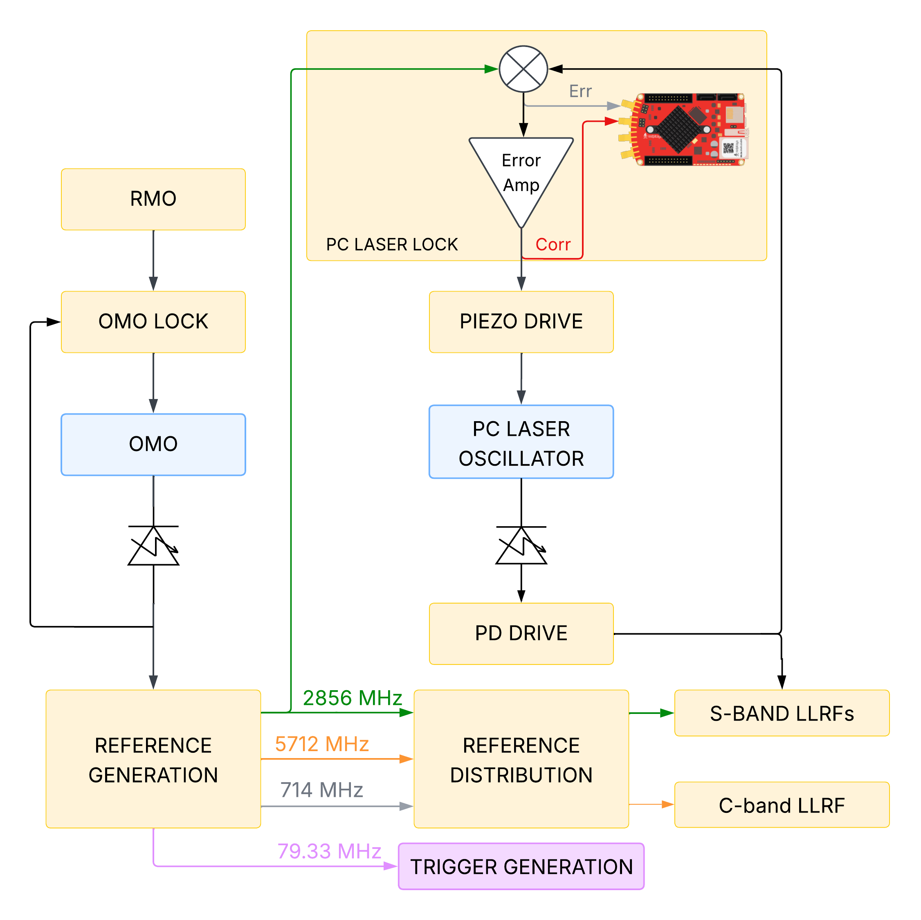

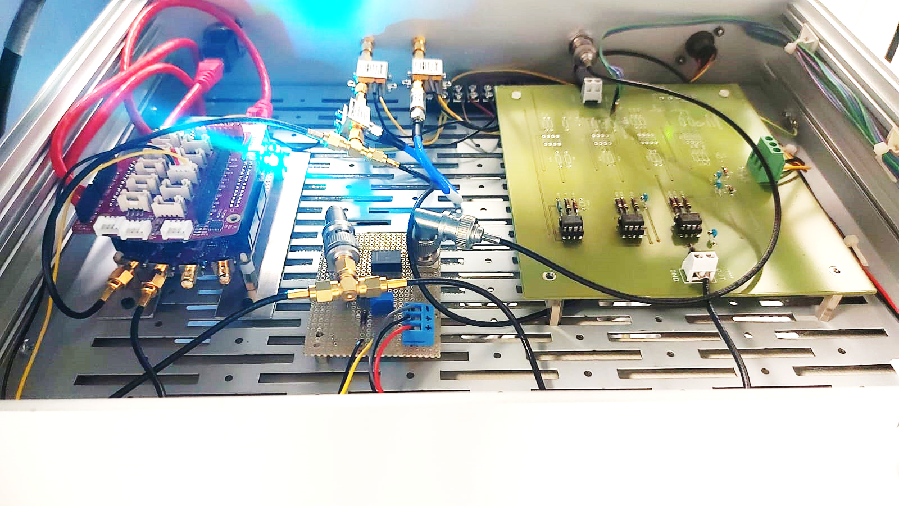



New RF control system – Photocathode laser phase lock control panel
Courtesy of M. Bellaveglia

Slide 16
New RF control system – Migration to EPICS
Before the SABINA project upgrade, each instrument was managed by separate LabVIEW software running on local controllers, each with its own configuration. Today, the control is centralized in EPICS: the softIOCs run in Kubernetes via Epik8s, with automatic Git-based synchronization through ArgoCD.
As part of the SABINA project, the RF control system has been completely updated. Control panels have been developed for the new LLRF systems and allow remote management of:
RF output power;
Pulse shape;
Amplitude and phase feedback;
Interlock management;
additional panels have also been developed for measurements and statistics.
The recent upgrade of the fast intra-pulse phase feedback of the klystron required the development of a remote control system integrating the LLRF with the Red Pitaya platform used for managing the electronics.
New photocathode laser phase lock electronics, with a dedicated control panel for remote management via Red Pitaya.
Development of Python softIOCs for automatic conditioning: first for the C-band line, and then for the gun after the cathode replacement.
Ongoing development of a custom EPICS application for RF system management.

Slide 17
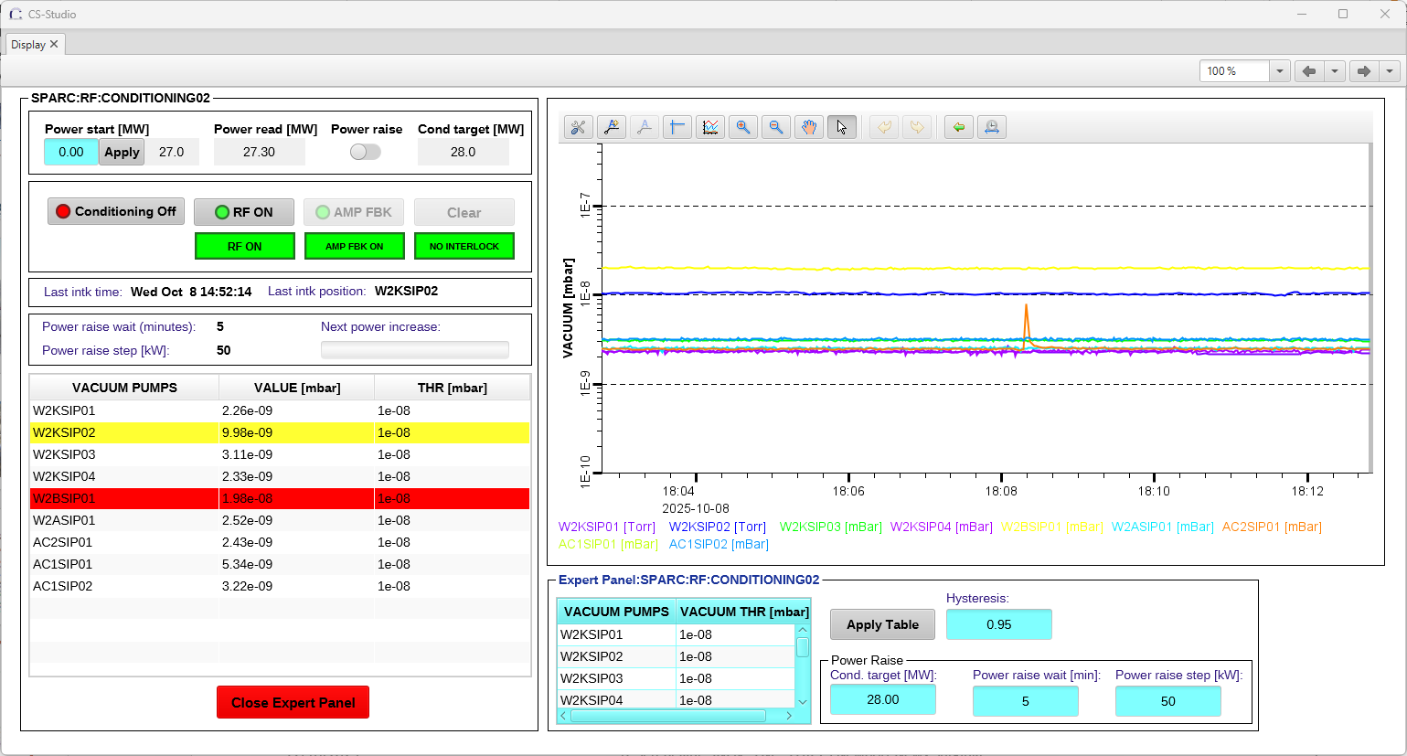




New RF control system – SoftIOCs for automatic conditioning

Slide 18
New RF control system – Migration to EPICS
Before the SABINA project upgrade, each instrument was managed by separate LabVIEW software running on local controllers, each with its own configuration. Today, the control is centralized in EPICS: the softIOCs run in Kubernetes via Epik8s, with automatic Git-based synchronization through ArgoCD.
As part of the SABINA project, the RF control system has been completely updated. Control panels have been developed for the new LLRF systems and allow remote management of:
RF output power;
Pulse shape;
Amplitude and phase feedback;
Interlock management;
additional panels have also been developed for measurements and statistics.
The recent upgrade of the fast intra-pulse phase feedback of the klystron required the development of a remote control system integrating the LLRF with the Red Pitaya platform used for managing the electronics.
New photocathode laser phase lock electronics, with a dedicated control panel for remote management via Red Pitaya.
Development of Python softIOCs for automatic conditioning: first for the C-band line, and then for the gun after the cathode replacement.
Ongoing development of a custom EPICS application for RF system management.

Slide 19
New RF control system developments at LNF-INFN
Thank you
for the attention

